Slide 1
Market Failure

Slide 2
What is market failure?
Markets fail when the free market forces of demand and supply lead to an allocation of resources that does not maximise the welfare of a country’s citizens. It means that the marginal social costs that result from the production and consumption of a good do not equal the marginal social benefits.
Economists often express market failure as a misallocation of resources or where resources have been allocated inefficiently.
Shortages
Surpluses
High Prices
Poor quality
Lack of innovation
market failure occurs when the community/social surplus (consumer surplus plus producer surplus) is not maximised.

Slide 3
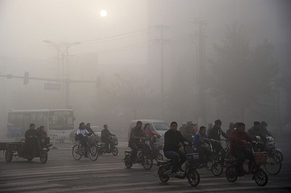
Inquiry case example - Living in one of the most polluted cities in the world
Around 10 million people live in one of China’s most polluted cities – Baoding. One resident claimed: ‘generally, there is smog on most days and we rarely see blue skies now.’ On bad days the visibility for driving is reduced and headlights and traffic lights are barely visible. There is also a metallic taste in air. The poor air quality accounts for very high levels of respiratory illnesses in the city, along with thousands of deaths. Baoding is in China’s Hebei province where the air is ‘fed’ by the chimney stacks of coal and steel plants.

Slide 4
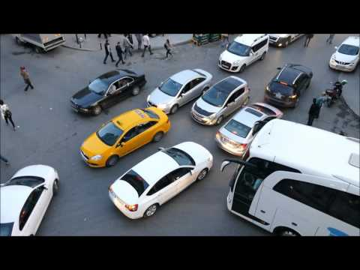
One of the more obvious examples of market failure caused by traffic congestion exists in Istanbul. Rapid urbanisation has made Istanbul one of the most congested cities in Europe, with traffic costing the city more than 5 billion Turkish Liras per year ($ 2bn) in lost revenue. This is caused by a loss of labour and excess fuel consumption, according to Kasım Kutlu, the general manager of the Istanbul Municipality - Affiliated Intelligent Transportation Systems (İSBAK).
1. Why is the absence of a comprehensive metro system an example of market failure?
2. Explain how an electronic road pricing scheme might help reduce the externality caused by excessive car consumption in the city?

Slide 5
Market Equilibrium and Efficiency
Allocative efficiency is achieved in a market when the quantity is produced at which the benefit society derives from the last unit is equal to the cost imposed on society to produce the last unit.
Allocative efficiency is achieved when Marginal Social Benefit = Marginal Social Cost
Assuming there are no “hidden” costs or benefits from the production or consumption of a good, a free market will achieve allocative efficiency when the equilibrium price and quantity prevail.
Consumer Surplus: Consumer surplus refers to the benefit enjoyed by consumers who were willing to pay a higher price than they had to for a good.
Producer Surplus: This is the benefit enjoyed by producers who would have been willing to sell their product at a lower price than they were able to.
Total Welfare: The sum of consumer and producer surplus. Total welfare is maximized when a market it in equilibrium. Any other price/quantity combination will reduce the sum of consumer and producer surplus and lead to a loss of total welfare.
Socially optimal output
The output level that reflects all the costs and benefits associated with a transaction i.e. it is the equilibrium that would be achieved if the market outcome reflects the effect of externalities. (Welfare is maximised)
Notes:
Market Efficiency
Allocative Efficiency
Explain that the best allocation of resources from society’s point of view is at competitive market equilibrium, where social (community) surplus (consumer surplus and producer surplus) is maximized (marginal benefit = marginal cost).
‹#›

Slide 6
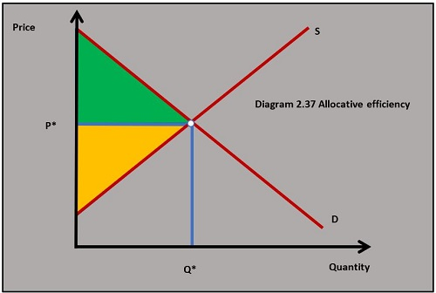
Allocative efficiency
Allocative efficiency is achieved in a market when the marginal benefit of consuming a good is equal to the marginal cost of producing it. This situation exists when demand equals supply, assuming there are no externalities in the market. External costs and benefits are explained in the next sections of this chapter.
When demand equals supply in a market it is in equilibrium and the social/community surplus is maximised. This means the consumer and producer surpluses are maximised. If all markets in the economy achieve maximum social/community surplus the welfare of a country’s citizens will be maximised.

Slide 7
Positive externality
Negative externality
External benefits
+
External Cost
+
Social benefits =
Social Cost =
Private benefit
Private Cost
No externality
No externality
Private benefits = all benefit
Private costs = all costs
Social benefits =
Social Cost =

Slide 8
Market Equilibrium and Efficiency
When a market is in equilibrium, resources are efficiently allocated. think about demand and supply in a new way.
Demand = Marginal Social Benefit (MSB):
The demand for any good represents the benefits that society derives from the consumption of that good.
Marginal benefits decrease at higher levels of output because additional units of a good bring benefits to fewer and fewer people the more of the good exists.
Supply = Marginal Social Cost (MSC):
The supply of a good represents the cost to society of producing the good.
For almost all goods, the greater the amount is produced, the more it costs to additional units of it.
Only when the MSB = MSC is society producing the right amount of any good. If output occurs at any other level, we must say that resources are misallocated towards the good.
Notes:
‹#›

Slide 9
Activity 1
for car & airport private & external costs Google classroom mindmap

Slide 10


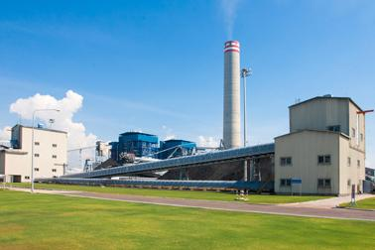

Private costs and benefits
Private sector firms
Aim to maximize their profits
Private costs = wages, rents, components, insurance premiums, telephone bills, electricity, etc.
Private benefits = revenue from the sale of products to consumers
Consumers
Aim to maximize their utility (or satisfaction)
Private costs = payments for goods and services
Private benefits = satisfaction from consuming the products they buy

Slide 11
Externalities
One way markets fail to achieve allocative efficiency arises from the existence of externalities in the market for a god
Externality Definition: An externality exists any time the production or consumption of a good creates spillover benefits or costs on a third party not involved in the market. In such cases, resources will either be under-allocated (positive externalities) or over-allocated (negative externalities) towards the production of certain goods.
External costs, external costs remain costs to society, regardless of who pays for them. Consider a firm that attempts to save money by not installing water pollution control equipment. Because of the firm's actions, cities located down river will have to pay to clean the water before it is fit for drinking, the public may find that recreational use of the river is restricted, and the fishing industry may be harmed. When external costs like these exist, they must be added to private costs to determine social costs and to ensure that a socially efficient rate of output is generated.

Slide 12
Examples of Positive Externalities (known as merit goods) | Examples of Negative Externalities (known as demerit goods)
Receiving a college education makes the consumer more likely to contribute to the well-being of society as a whole | Driving sports-utility vehicles contributes to traffic and contributes more to global warming
Riding bicycles to work reduces congestion on the roads and makes for less traffic for everyone else | Producing electricity using coal creates greenhouse gas emissions and air pollution
Getting vaccines against communicable diseases reduces the chance you will get others sick | Smoking cigarettes contributes to lung disease among not just the smokers, but those who suffer from second-hand smoke

Slide 13
Negative Externalities of Production
Negative Externalities of Production: These arise when the production of a good creates spillover costs on a third party, which is often times the environment as a whole. The Marginal Social Cost of producing a good is greater than the Marginal Private Cost of producing it… Example: A polluting industry. In the graph…
MPC = The private costs of producing the good
MSC = the cost to society of producing the good, includes the MPC plus any external costs
Qe = the actual output in the market
Qso = The socially optimal output in the market (allocative efficiency)
Pe = the equilibrium price in the market
Pso = the socially optimal price if all social costs were considered in the good’s production
P
Polluting industry
MSC
S=MPC
distance b/w MPC
& MSC = external costs
P_{so}
P_{e}
D=MSB
Q_{so}
Q_{e}
Q
Q_{e} > Q_{so}: resources are over-allocated towards the polluting industry

Slide 14


Slide 15
Inquiry case example - Erin Brockovich
In 1993 an American paralegal called Erin Brockovich built a case against the Pacific Gas and Electric Company (PG&E). The company had been using a substance called hexavalent chromium in one of its cooling towers to prevent corrosion. The contaminated water from the plant made its way into the groundwater near the town of Hinkley, California. The contaminated water caused very significant health problems for many of Hinkley's residents. The case was settled in favour of the residents in 1996 for US$333 million, the largest settlement ever paid in a direct-action lawsuit in US history.
The case was made into a film called ‘Erin Brockovich’, starring Julia Roberts in the title role. It was nominated for five Academy Awards. The PG&E example is one of many high-profile examples of production negative externalities.
Questions
a. Define the term negative production externality. [2]
b. Using a diagram, explain how negative production externalities lead to market failure in the energy market. [4]
Investigation
Investigate any other films based on a similar theme of negative externalities of production.

Slide 16
Positive Externalities of Consumption
Because of there are external benefits of consuming education:
The Marginal Social Benefits of receiving an education (MSB) are greater than the Marginal Private Benefits of receiving an education (MPB).
If left to the free market, too few people will receive the highest levels of education
In the market on the right:
Private demand for education is equal to the marginal private benefit.
The quantity of education society will consume if it is left entirely to the free market is Qe, but this is less than what is socially optimal (Qso)
There are external benefits of receiving an education, represented by the vertical distance between MPB and MSB
P
Market for Education
S=MSC
=MPC
P_{so}
P_{e}
distance b/w MSB
& MPB = external benefits
D=MPB
MSB
Q_{e}
Q_{so}
Q
Q_{so} > Q_{e}: resources are under-allocated towards the education industry

Slide 17
Information failure
Information failure is another, significant, market failure and can occur in two basic situations.
Consumer it is important to be fully informed to make the correct choice to maximise benefit and satisfaction
Firstly, information failure exists when some, or all, of the participants in an economic exchange do not have perfect knowledge. Secondly, information failure exists when one participant in an economic exchange knows more than the other, a situation referred to as the problem of asymmetric, or unbalanced, information.
The job applicant, who fails to reveal at a job interview that they do not have a particular skill for the job.
The estate agent, who exploits the fact that a potential buyer of a property has very little knowledge about the property, and any possible problems.
The cigarette manufacturer, who does not inform smokers of the true health risk of smoking.
The buyer of a Financial products, who is unaware of the true level of risk, as in the case of derivative products.
The seller of a pension, who misleads purchasers about the financial value of the pension. Indeed, widespread pension 'miss-selling' by large UK insurance companies, occurred at the end of the 1990s.

Slide 18
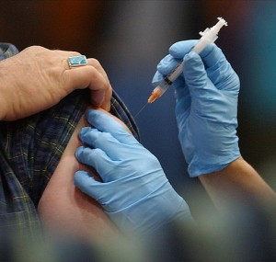

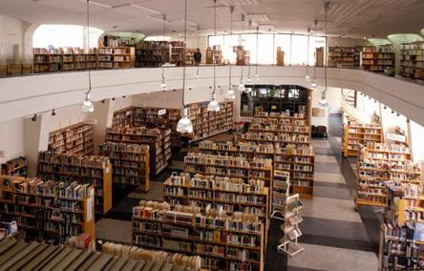
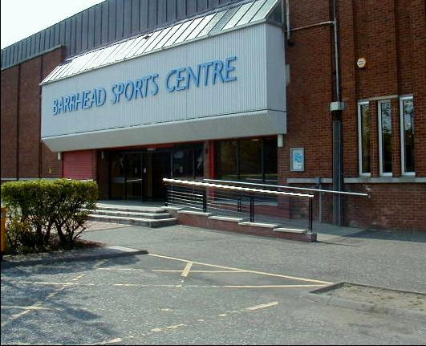

Slide 19
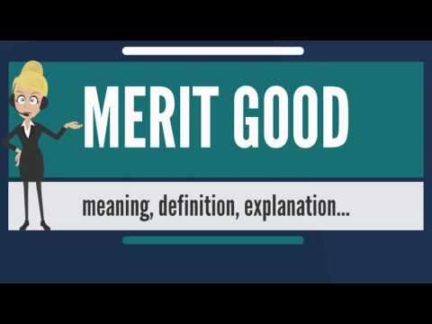

Slide 20
Merit Goods
Merit goods are those goods and services that the government feels that people will under-consume, and which ought to be subsidised or provided free at the point of use so that consumption does not depend primarily on the ability to pay for the good or service.
Are goods that are held to be desirable for consumers, but which are underprovided by the market.
Reasons for under-provision include:
The good may have positive externalities. In this case too little is provided by the market. immunization programs .
Low levels of income and poverty. Some consumers may want certain goods or services but cannot afford to buy them. Examples include health care services, medicines, education and recreational facilities, which people on low incomes often cannot afford to buy in the market.
Consumer ignorance. Consumers may be better off if they consume certain goods and services but they may be ignorant of the benefits, and so do not demand them. E,g preventive health care (such as immunisation, annual health check-ups) can prevent serious diseases, but lack of knowledge about the benefits may lead consumers to demand too little of these services.
P
Market for Education
S=MSC
=MPC
P_{so}
P_{e}
distance b/w MSB
& MPB = external benefits
D=MPB
MSB
Q_{e}
Q_{so}
Q
Q_{so} > Q_{e}: resources are under-allocated towards the education industry

Slide 21
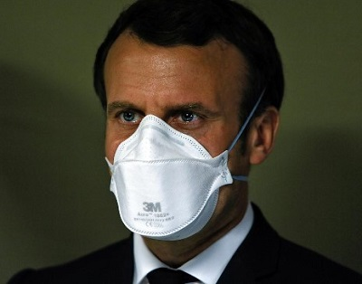
In google classroom for activity
Dr Beng Goh is a consultant physician at Royal London Hospital discusses the use of face masks to protect the population from Covid-19. He argues that as people use face masks together with social distancing and hand-washing, this will significantly reduce the transmission of coronavirus and saves people’s lives. France is the latest country to advise the use of face masks along with the US, Austria and Singapore. Covid-19 is often spread when tiny viral particles people breathe in crowded places like trains and buses. Masks are seen as an important way of preventing this. Masks protect those wearing them from contracting Covid-19 and they also protect third parties from contracting the infection as well.
Questions
a. Define the term merit good. [2]
b. Explain two reasons why merit goods such as face masks might be under-provided in a free market economy. [4]
Investigation
Research into other examples merit goods related to the Covid-19 crisis?

Slide 22
(a) What is a merit good?
(b) Identify some examples from the video of goods that provide obvious positive benefits to any society.
(c) Why are many merit goods under demanded (relative to the social optimum level of production), in free market systems?
(d) What other reasons does the video give to explain why many merit goods are provided by governments?
(e) Outline a criticism of merit good provision by governments.

Slide 23
Applying the theory to Flu vaccinations
(a) What are the spillover costs associated with flu shots?
(b) why does this represent a market failure in free market systems?

Slide 24

In USA most University and health services are paid for by the consumer at the point of sale. By contrast in most European countries those services are paid for out of general taxation. Discuss the merits of both American and European systems of providing those services after watching the following video:
In groups

Slide 25
Government Responses to Positive Externalities
When a market fails by under-allocating resources towards the production of a good, society stands to benefit from increasing the production and consumption of the good in the market. Therefore, government policies aimed at increasing either the supply or the demand for the good can improve efficiency in the market for merit goods. Such policies include:
Corrective subsidies (to producers): A subsidy is a payment from the government to producers. Subsidies lower the marginal private costs of production, increasing the supply, reducing the price and increasing the quantity demanded for the good being subsidized.
Government provision: Many merit goods are provided by the government, such as education, health care, infrastructure like bridges and airports, police security, and so on.
Positive advertising: Government programs that educate consumers about the positive private and social benefits of a good may increase demand for the good, incentivizing firms to produce more of it. Examples include healthy eating campaigns, safe sex campaigns (to encourage condom use) promoting flue shots (and other vaccines), and so on…
Notes:
Corrective subsidies (to consumers): A subsidy to consumers of a good will increase the marginal private benefit of consumption (since individuals now get paid to buy a good) and increase the demand for the good. The higher price incentivizes firms to provide a greater quantity, resulting in a more efficient allocation of resources towards the good

Slide 26
Government Responses to Positive Externalities – Corrective Subsidies
A subsidy to producers reduces the marginal private costs of production and increases the supply of the good being subsidized. In the markets below, the government is subsidizing eco-tourism providers and private schools. Both subsidies lead to a greater equilibrium quantity, a lower equilibrium price, and an increase in total welfare in society.
P
Eco-tourism industry
S=MPC
P
Market for Education
S_{with subsidy}
=MSC
S=MSC
=MPC
P_{e}
S_{with subsidy}
P_{so}
P_{so}
P_{e}
D=MSB
D=MPB
MSB
Q_{e}
Q_{so}
Q
Q_{e}
Q_{so}
Q

Slide 28
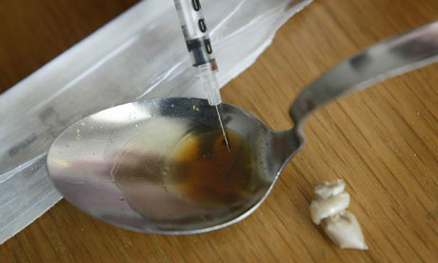
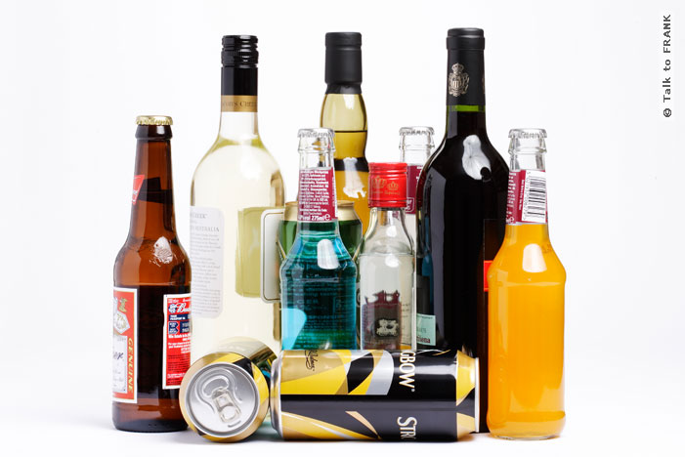
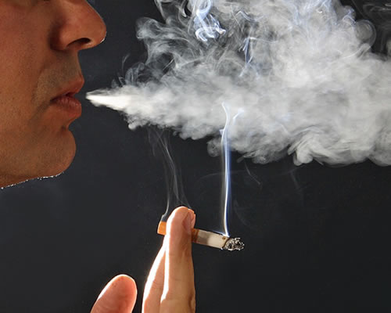

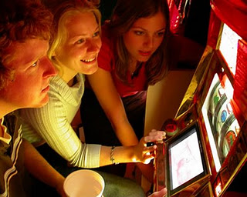
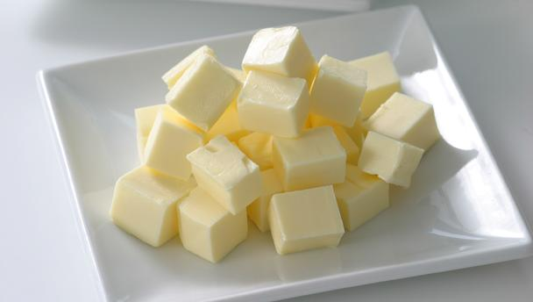
What type of goods are these call?

Slide 29

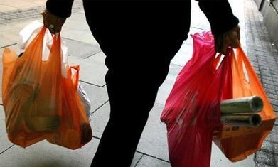


Slide 30
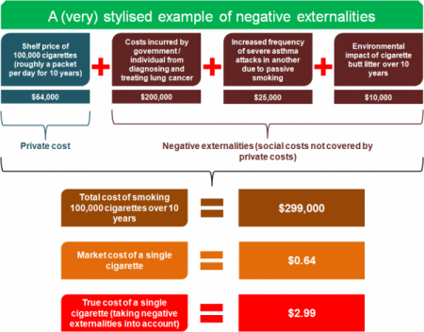

Slide 31
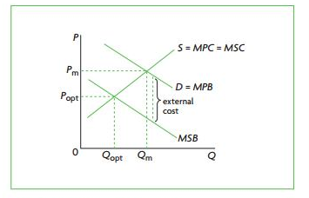
Negative consumption externalities (demerit goods)
Consumption of good & services creates an external that damaging third party.
E.g Smoking in public places in the form of passive smoking.
Creating external costs in the form of higher health costs additional burden upon society.
Marginal private benefit (MPB) does not reflect the Marginal social benefit MSB (negative benefits)
Therefore causing MSB curve to lie below the MPB curve
The vertical difference is the external cost
MSC>MSB
Socially optimum at intersection of MSB & MSC curves
Others driving cars co2 emissions/heating homes
Notes:
refer to external costs created by consumers. For example, when consumers smoke in public places, there are external costs that spill over onto society in the form of costs to non-smokers due to passive smoking. In addition, smoking-related diseases result in higher than necessary health care costs that are an additional burden upon society. When there is a consumption externality, the marginal private benefit (demand) curve does not reflect social benefits. In Figure 5.6, the buyers of cigarettes have a demand curve, MPB, but when smoking, create external costs for non-smokers. These costs can be thought of as ‘negative benefits’, which therefore cause the MSB curve to lie below the MPB curve. The vertical difference between MPB and MSB represents the external costs. Note that since the

Slide 32
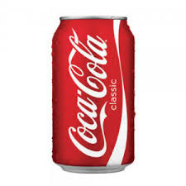

Characteristics Private Goods
Private good
bottle of coke
Rival
One persons consumption reduces amount left for others to consume
Excludable
Consumer can be excluded from consuming the product if not will to pay
Private goods can be rejectable
Notes:
Private good; a good or service that is individually consumed and that can be profitably provided by owned firms (i.e. automobiles, clothing, personal computers, etc)
Rivalry (in consumption):
When one person buys and consumes a product, it is not available for another person to buy and/or consume.
Ex. When Adam purchases and drinks a bottle of water, the same bottle of water Adam has is not available for Benson to purchase and consume.
Ex. If Linda buys and uses a Wii, it is not there for Jason to buy and use.
Ex. If I buy a BMW car, you cannot buy the same car I bought.
Excludability (by a seller):
Only those who can afford a product may obtain its benefits.
Ex. Person A may have the means and will to pay for a t-shirt for $20. Person B may not wish to pay $20 or may not be able to; person B would not be able to purchase the good.
Ex. Only people who are willing and able to pay the market price for bottles of water can obtain these drinks and the benefits they confer.
* These characteristics ensure that firms in a free market may find it profitable to produce and sell such private goods and if they are profit-seekers, suppliers enter the market and produce the desired goods.

Slide 33
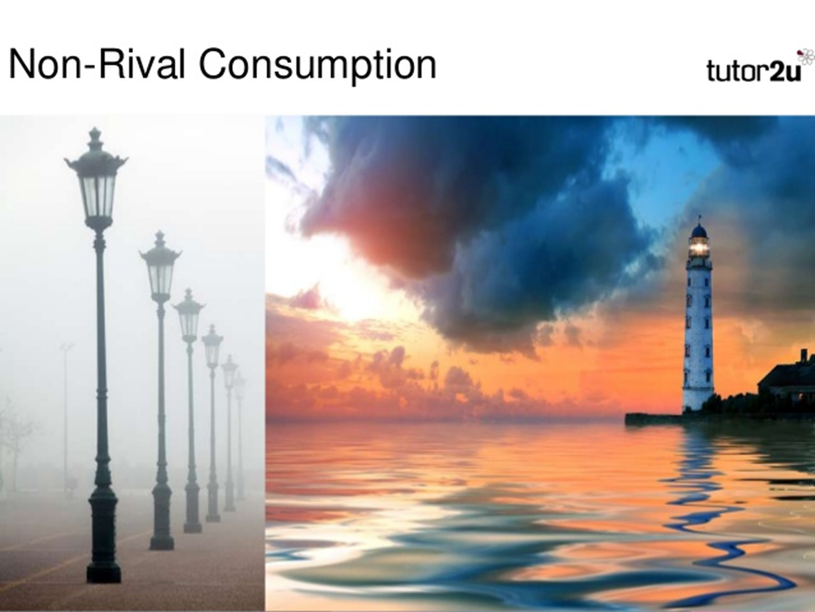
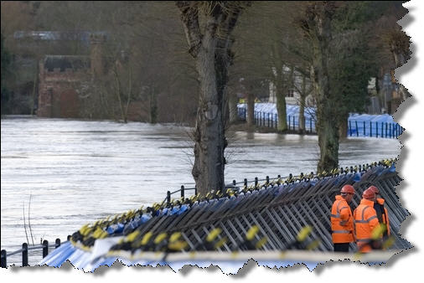
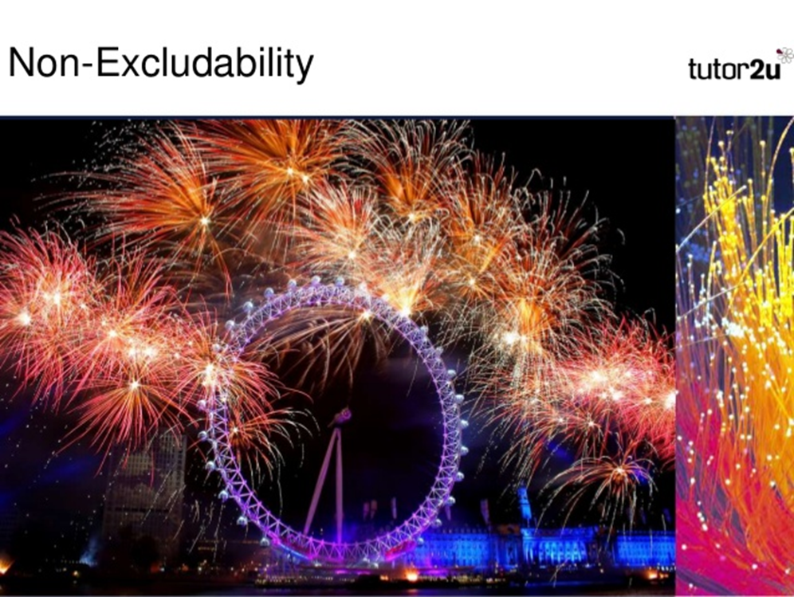
Characteristics Public Goods
Non-rival
One person’s consumption of good not prevent others consuming it
Non-Excludability
No way to exclude individuals from benefiting of that good
Non- reject ability
Goods/service can not be rejected (police force)
Notes:
Characteristics of Public Goods
Non-rivalry (in consumption):
One person's consumption of a good does not prevent the others from consuming it.
Ex. Everyone can simultaneously obtain the benefit from a public good such as national defense, street lighting, public toilets, a global positioning system, or environmental protection without exerting any extra effort than the effort that is being put forth in a normal day without taking the benefit's costs into account.
Non-excludability (by a seller):
There is no effective way of excluding individuals from the benefit of the good once it comes into existence.
Ex. Once in place, one cannot exclude another from benefiting from national defense, street lighting, a global positioning system or environmental protection.
Ex. There is no way to exclude people from looking at a public statue in the park. Say that Ana paid her taxes (that paid for the statue) and Alan didn't. They are both allowed to view the statue. Alan doesn't have to wear blindfolds every time he walks by.
Note: Public goods are a market failure because resources are under allocated towards producing them. The market fails to provide these goods.
Examples:
Street lighting / Lighthouse Protection, Police services, Air defence systems, Roads / motorways, Terrestrial television, Flood defence systems, Public parks & beaches Because of their nature the private sector is unlikely to be willing and able to provide public goods. The government therefore provides them for collective consumption and finances them through general taxation.
Consumption of public goods creates the free rider problem:
Everyone can benefit from the good; therefore, people have no incentive to pay for something free – "free riders".
If demand is not fully expressed in market, it is impossible for firms to gather together resources and profitably provide the good.
Solution: government provision of public goods through taxation. However, the free rider problem may still exist if illegal immigrants do not pay taxes and still enjoy the benefits of the goods in question.
**Note: Controversy often arises over how mixed goods (ie excludable/nonrivalrous or nonexcludable/rivalrous) should be categorized.
Example: Highways with tollbooths: these roads are charged but one person driving on a highway does not usually reduce the usefulness of the highway to others.
Example: You cannot exclude someone from fishing in a public lake, but once a fish is caught it cannot be caught by any other fishermen.

Slide 34
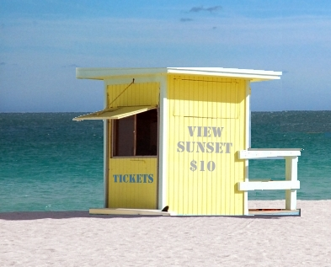
Why would the ‘market for viewing the sunset’ be a missing market?

Slide 35
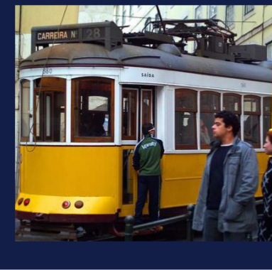

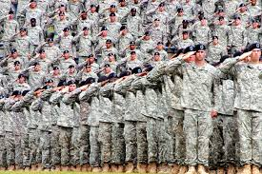
Free rider problem & Market failure
Free rider problem
Everyone can benefit from the good; therefore, people have no incentive to pay for something
Market failure
Not allocating resources in an optimal manner
Publics goods benefit society lack of public goods in free market ➔ market failure
Government intervene

Slide 36
Public Goods
But what if a market produced NONE of a good. A good which is not provided by the free market AT ALL is known as a PUBLIC GOOD.
Public Good: A good which provides benefits to society which are non-rivalrous, and the benefits of which are non-excludable by the provider of the good. Because of these characteristics, public goods will not be provide by the free market at all (hence, represent a market failure)
To be considered public, a good must be:
Non-rivalrous in consumption: This means that one consumer’s enjoyment of the benefits of a good does not diminish any other consumer’s enjoyment of its benefits.
Non-excludable by the provider: This means that once a good has been provided, it is not possible to exclude any individuals from enjoying its benefits. In other words, you can’t make individuals pay for the good once it is made available. There will be free-riders, or individuals who enjoy the good’s benefits without ever paying for it!
Private good: Is both rival & excludable, Merit & demerit are private goods

Slide 37
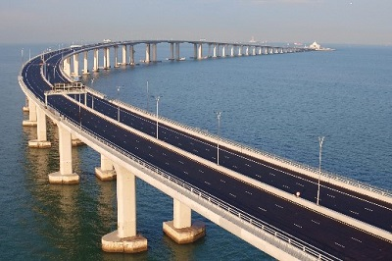
Inquiry case example
The Hong Kong–Zhuhai–Macau Bridge
On the 24 October 2018 the Hong Kong–Zhuhai–Macau Bridge was opened. It is a 55km (34 miles) bridge that included an undersea tunnel and four artificial islands. It is the longest sea crossing by bridge in the world. The project cost $18.8 billion. The improved connectivity brought about by the bridge will bring significant social benefits to Hong Kong and Macau. Sectors such as tourism, finance and logistics will see huge advantages from the bridge.
Discuss the private and external benefits that might come from the Hong Kong–Zhuhai–Macau Bridge.
Research another infrastructure project that might have similar private and external benefits.

Slide 38
Examples of Public Goods
To find examples of public goods, all we have to do is walk out our front door and look around. Much of what government provides us using our tax money are examples of public goods. These may include:
Infrastructure: Roads, sidewalks, street lights, power lines, sewage systems, train tracks… many of these goods are non-excludable and non-rivalrous, therefore are unlikely to be provided by the free market. Government must provide such goods so that society can enjoy their benefits.
Parks: Think of the last time you walked through a public park. Did you have to pay to get in? (If not, then it was non-excludable). Did your enjoyment of the park prevent others from enjoying it? (If not, then it was non-rivalrous). Public parks are an example of public goods.
Fire and Police Protection: If your house catches on fire, do you have to call a private fire fighting firm to come put it out? The reason you don’t is because the benefits of having fire protection are non-rivalrous. Putting the fire in your house out will benefit your neighbors, whose houses are less likely to burn down. Police protection is the same way. Without government-provided police force, society as a whole would be unsafe because very few people would choose to hire private security. The benefits of police protection are non-rivalrous and non-excludable.
National Defense: An army, navy and air force provide citizens with protection which, once provided, individuals within the nation cannot be excluded from benefiting from. One person’s safety does not diminish others’, so defense is non-excludable and non-rivalrous: a purely public good.

Slide 39
The Abuse of Monopoly Power as a Market Failure
Monopoly Power: When a single firm controls a large share of the total market for a particular good, that firm is able to charge a HIGHER PRICE and produce a LOWER QUANTITY than what is socially optimal.
The source of monopoly power arises from a large firm’s price-making abilities.
In more competitive markets, hundreds of small firms compete with one another for the business of consumers.
Competition forces firms to produce their goods efficiently (at a low cost) and sell their goods for a low price
Without competition, monopolists are not forced to produce at the lowest cost, nor do they have to sell for the lowest price.
Monopolists (or firms with significant market power), are both productively and allocatively inefficient, since without competition, such firms are able to charge higher prices and produce smaller quantities!
Price fixing is when two or more entities, usually companies, agree to sell a product at a set price. They do this to maintain profit margins. Acting as a monopoly

Slide 40
The government can regulate monopolies through:
Price capping – limiting price increases
Regulation of mergers
Breaking up monopolies
Investigations into cartels and unfair practises
Remove restrictions on entry into new markets

Slide 41
Immobility of resources
Factor immobility is a cause of market failure. The free market fails to provide an efficient allocation of resources because of the geographical and occupational immobility's.
Geographical immobility – When it is difficult to move from one geographical area to another. (housing)
Occupational immobility – difficult to move from one type of work to another. (They may have specific skills that are not necessarily needed in growing industries which causes a mismatch between the skills)
Policies to overcome factor immobility
Improve provision of information
Subsidise firms to move to depressed areas.
Subsidies housing for workers
Education and retraining for workers who don’t have relevant skills.

Slide 42
Short-termism
Short-termism arises when a business prioritises short-term rather than long-term performance.
Due to firms seeking
Share price
Revenue growth
Gross & operating profit
Unit costs & productivity
Economies (firms) under investing in capital goods producing consumer goods thus higher standard of living
Lack of investment in capital goods will cause a decrease in future output of the economy
Government can cut taxes for firms and undertake investment by itself

Slide 43
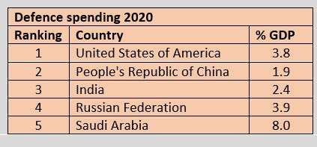
The current level spending of annual defence by the US government is $934 billion. This is almost 4 percent of its GDP. Its spends 3 times as much as China which is the next biggest spender on defence. The decision by the US to spend as money as it does on defence is heavily influenced by political factors. It does, however, come at a significant opportunity cost in terms of other items of expenditure the US government could spend its money on such as health and education.
Question
Explain why national defence is an example of a public good. [4]
Explain the free rider problem. [2]

